Slide 1

Project Hear
What Is It?

Slide 2
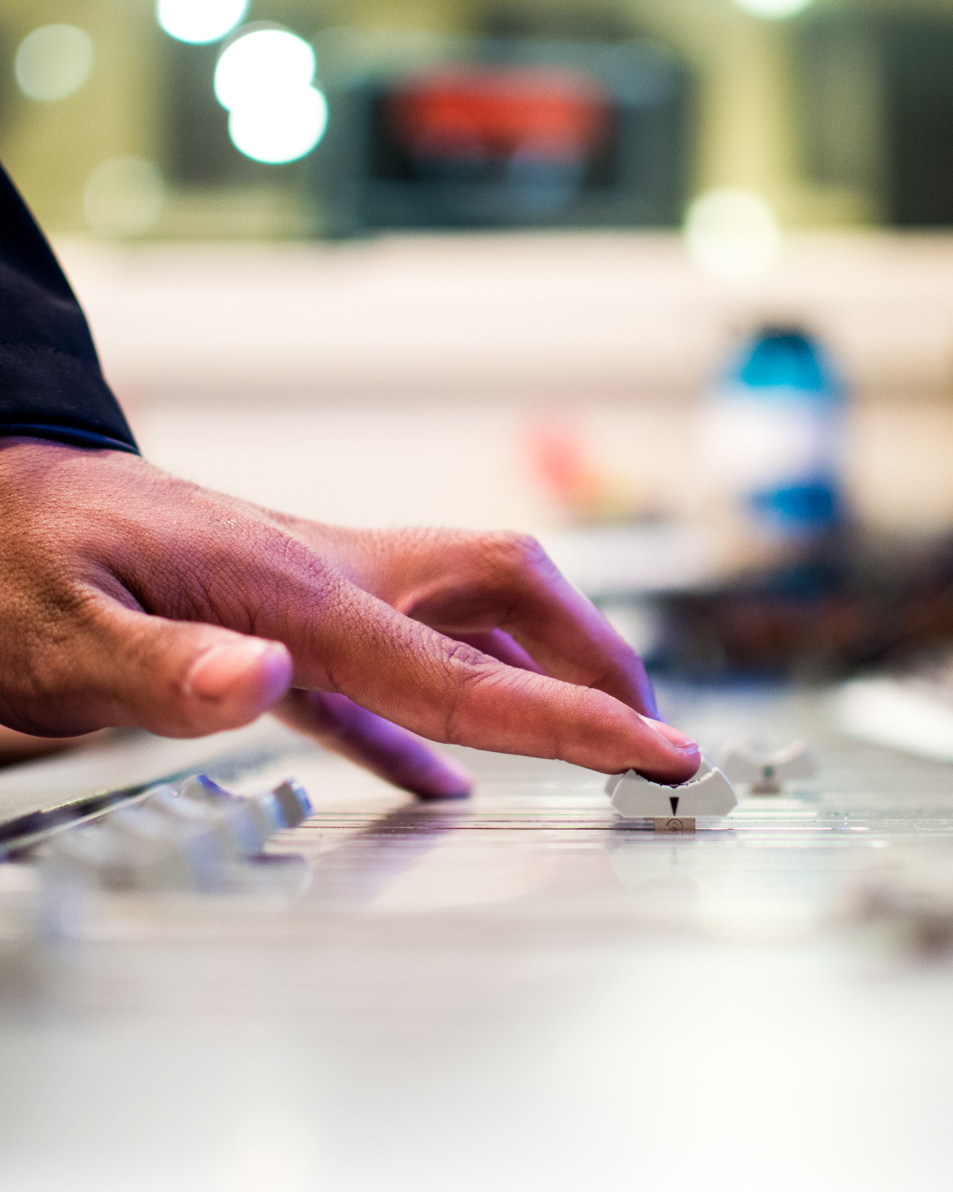
Aim
Hearing Protection
Sound Level Monitoring
Simple, Portable Solution
Interesting

Slide 3
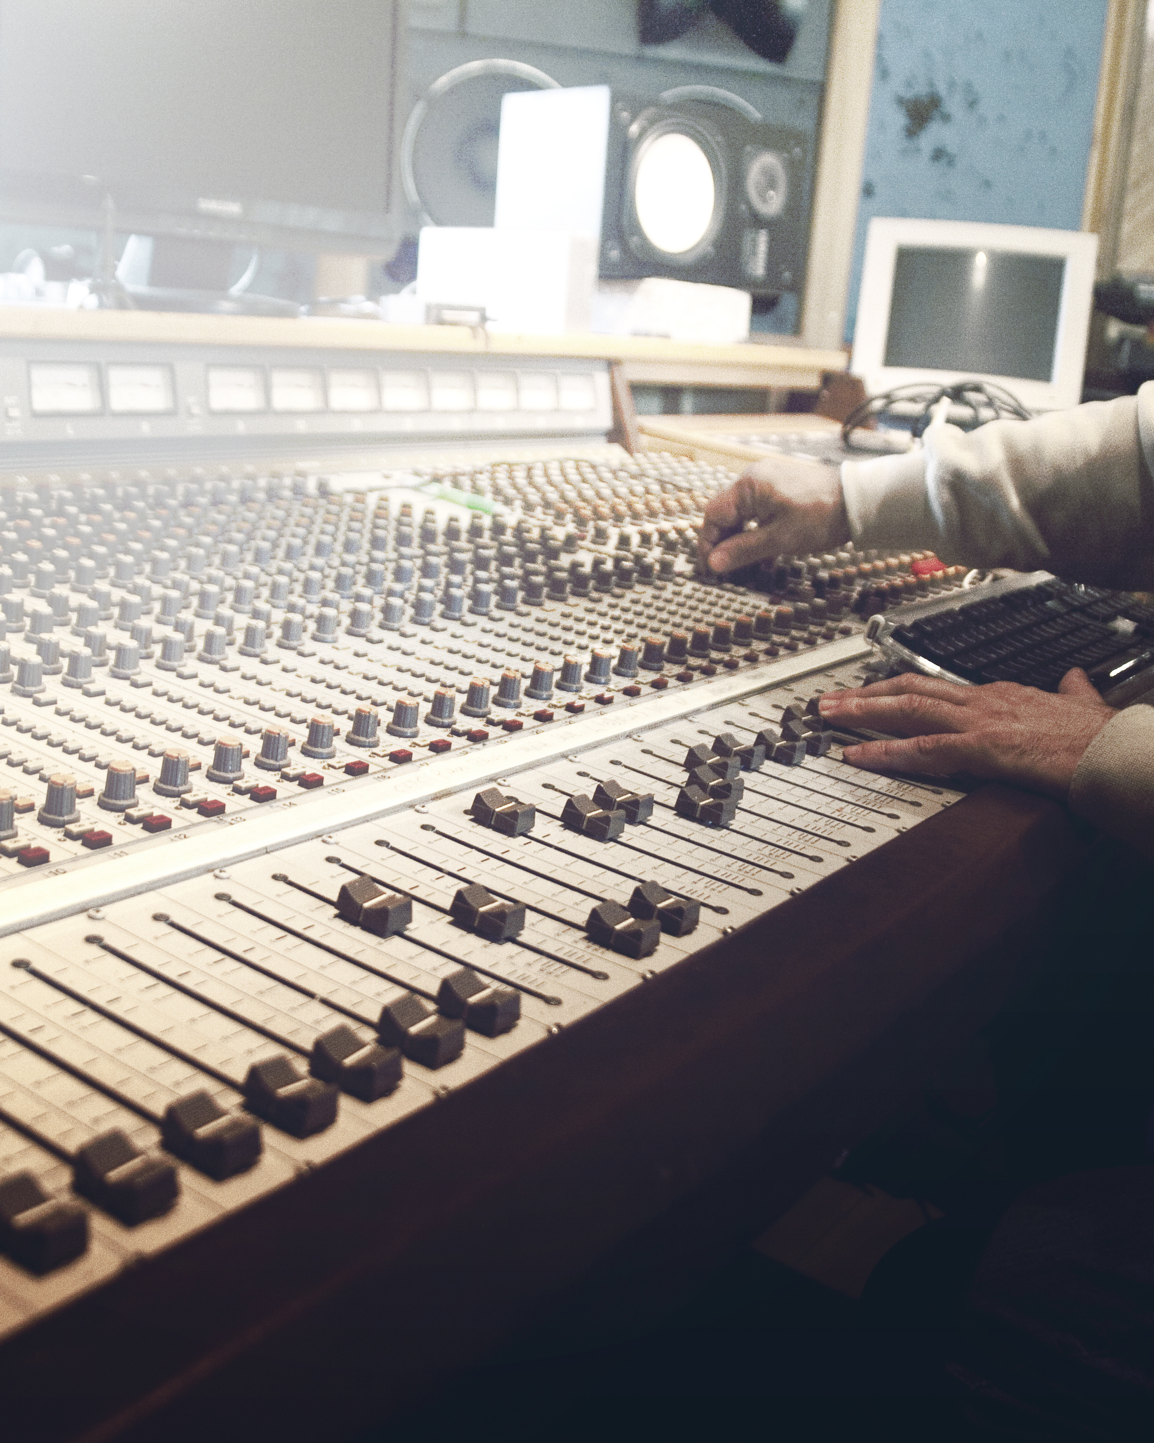
Why
My Interest
Own Experience
Market Opportunity
Similar Projects Online

Slide 4
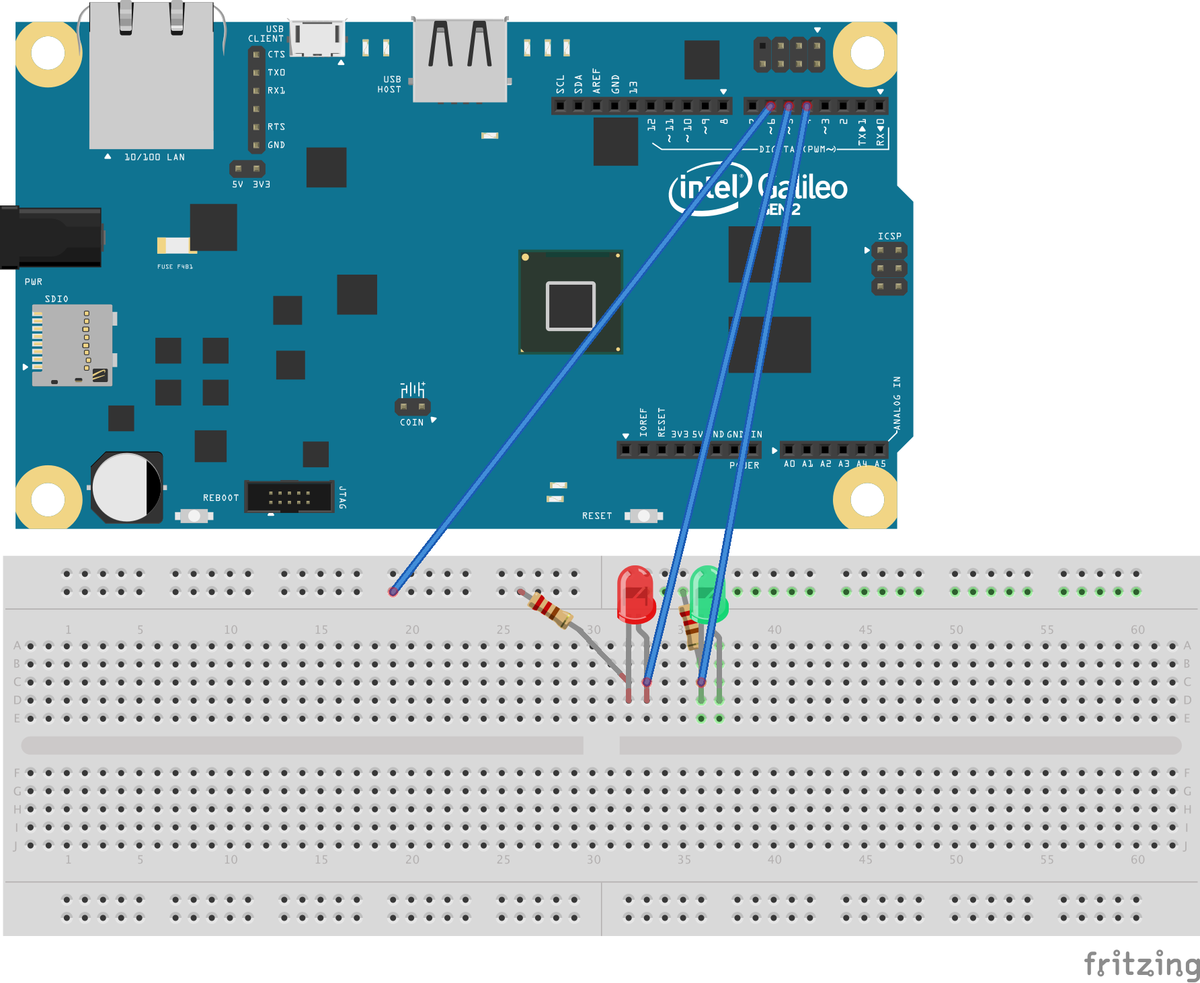
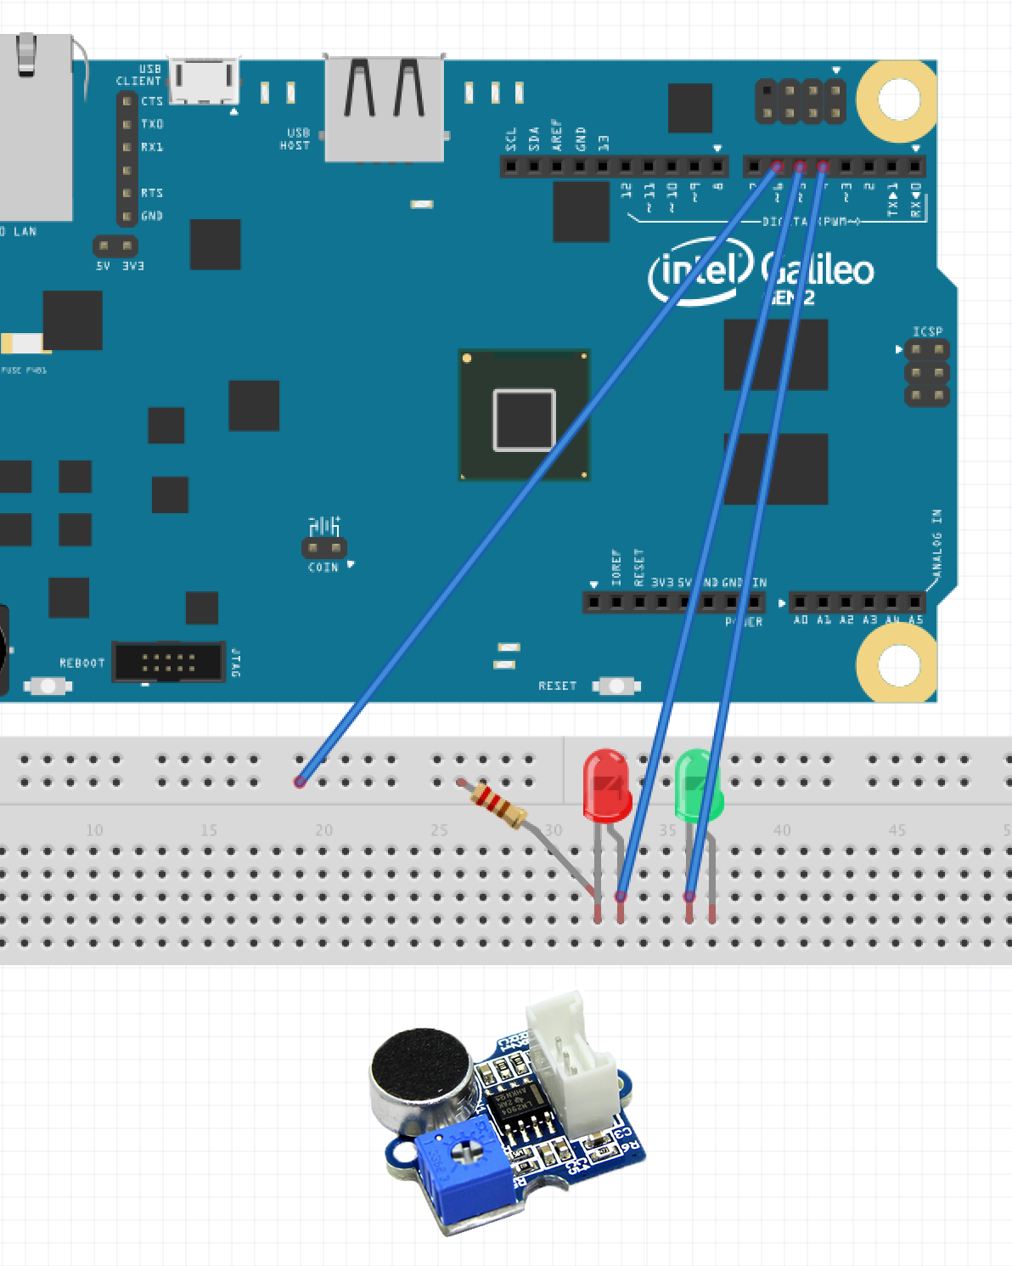
How
Intel Galileo
Green & Red LED
Breadboard
Groove Loudness Sensor

Slide 5
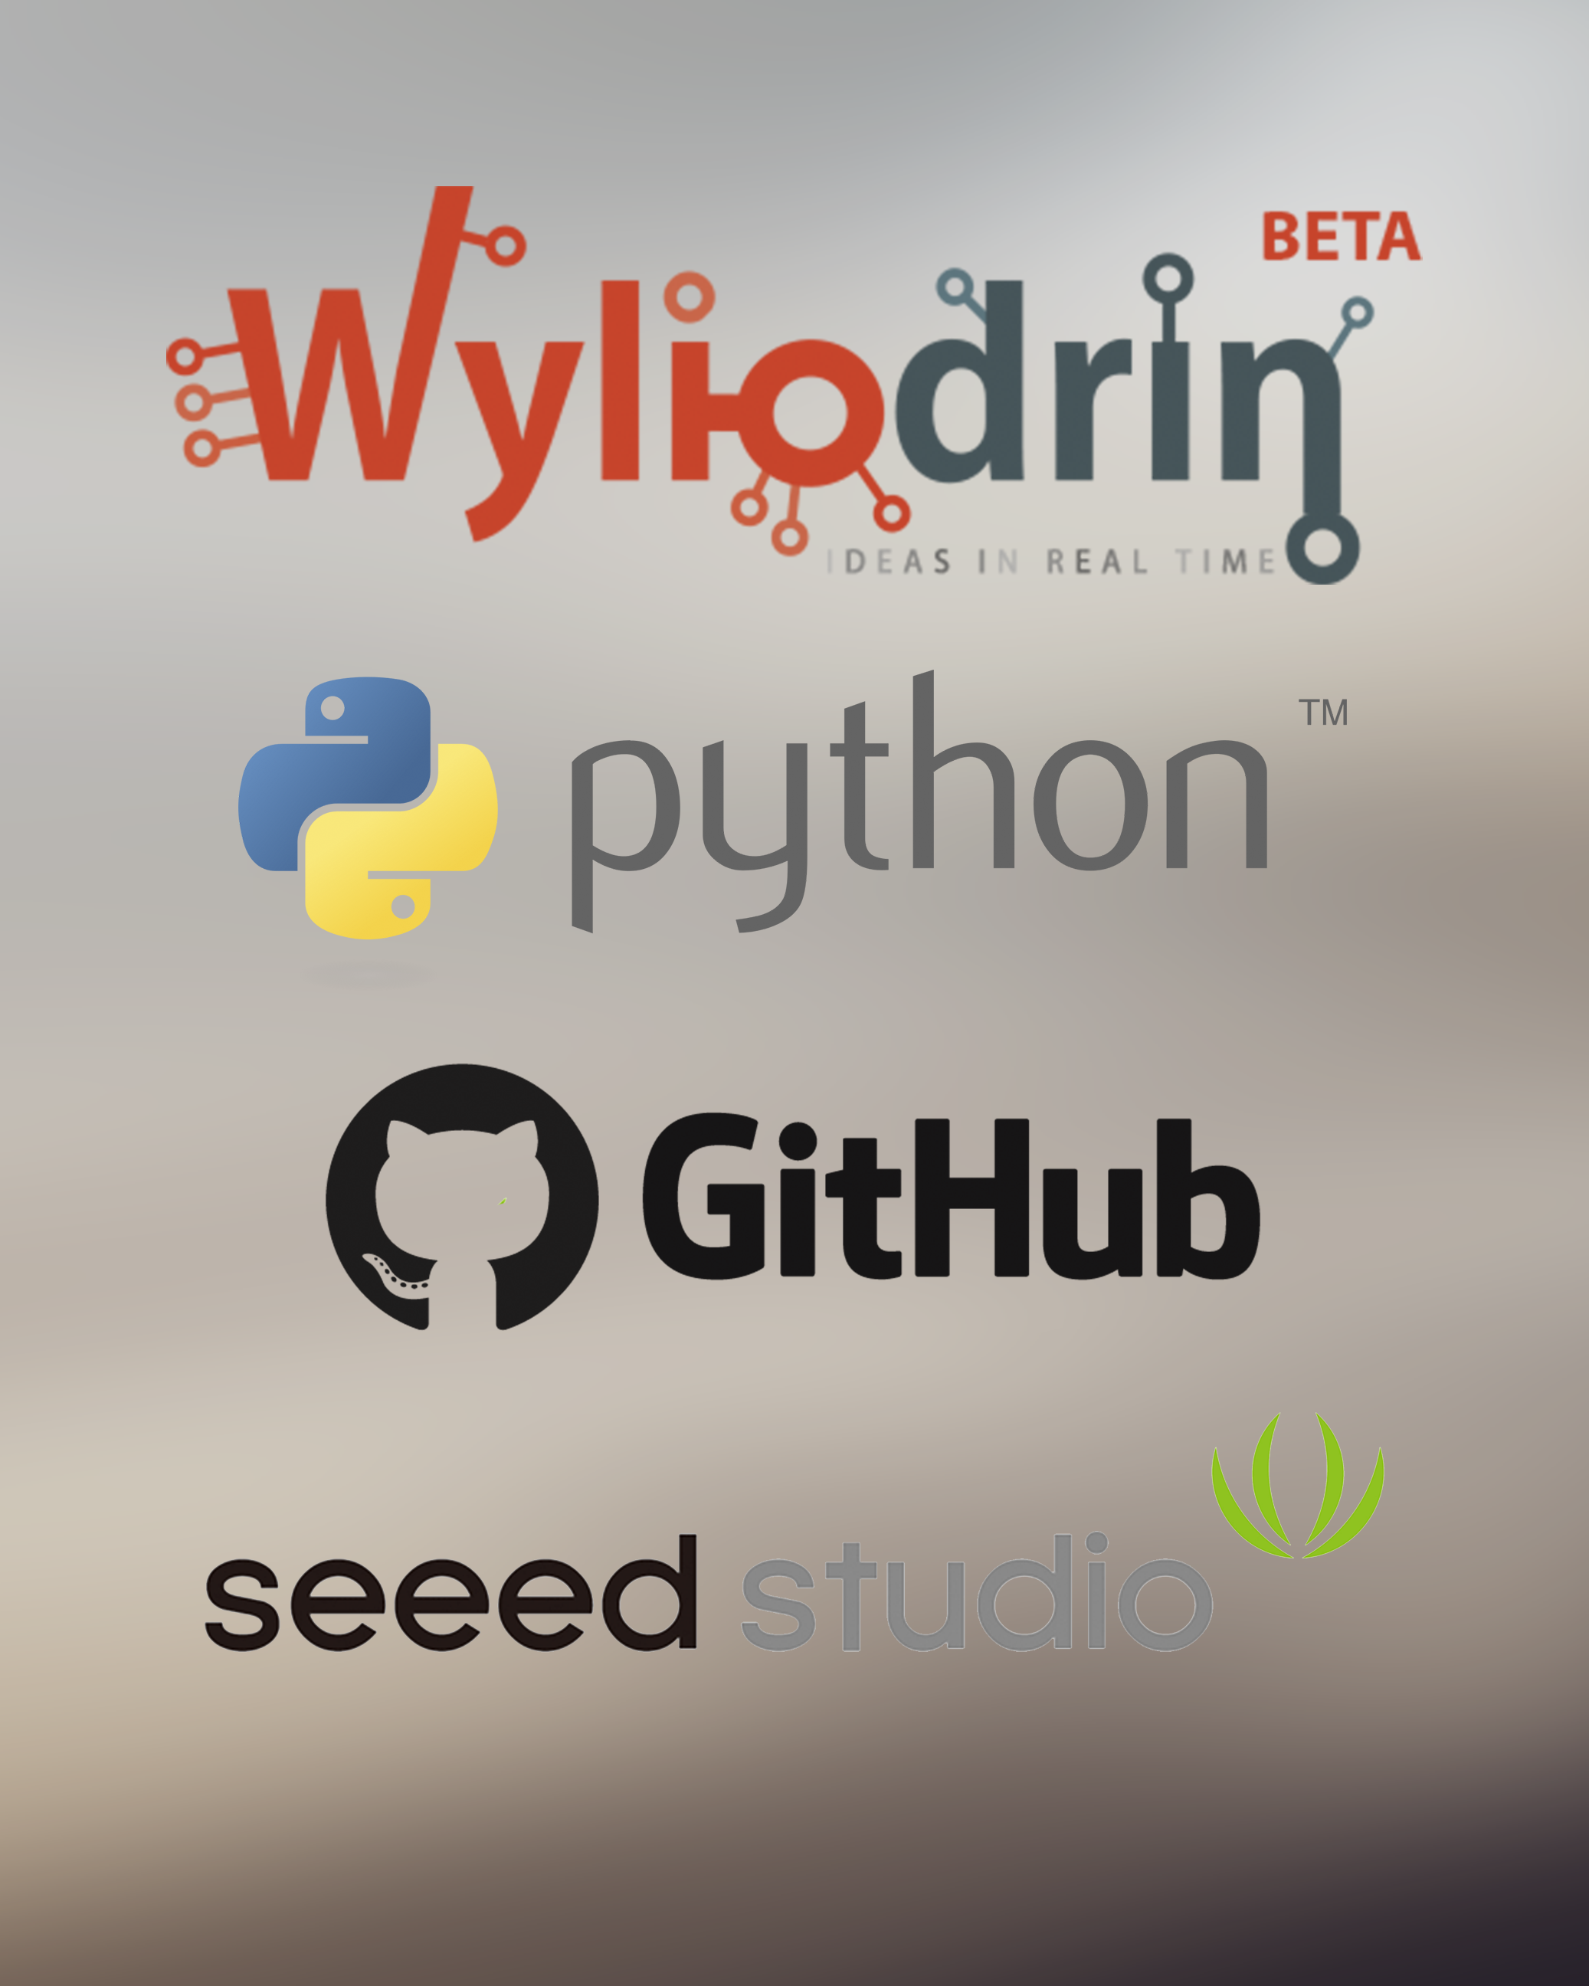
Tech
Wyliodrin IOT
Python
Github
Seeed Wiki

Slide 6
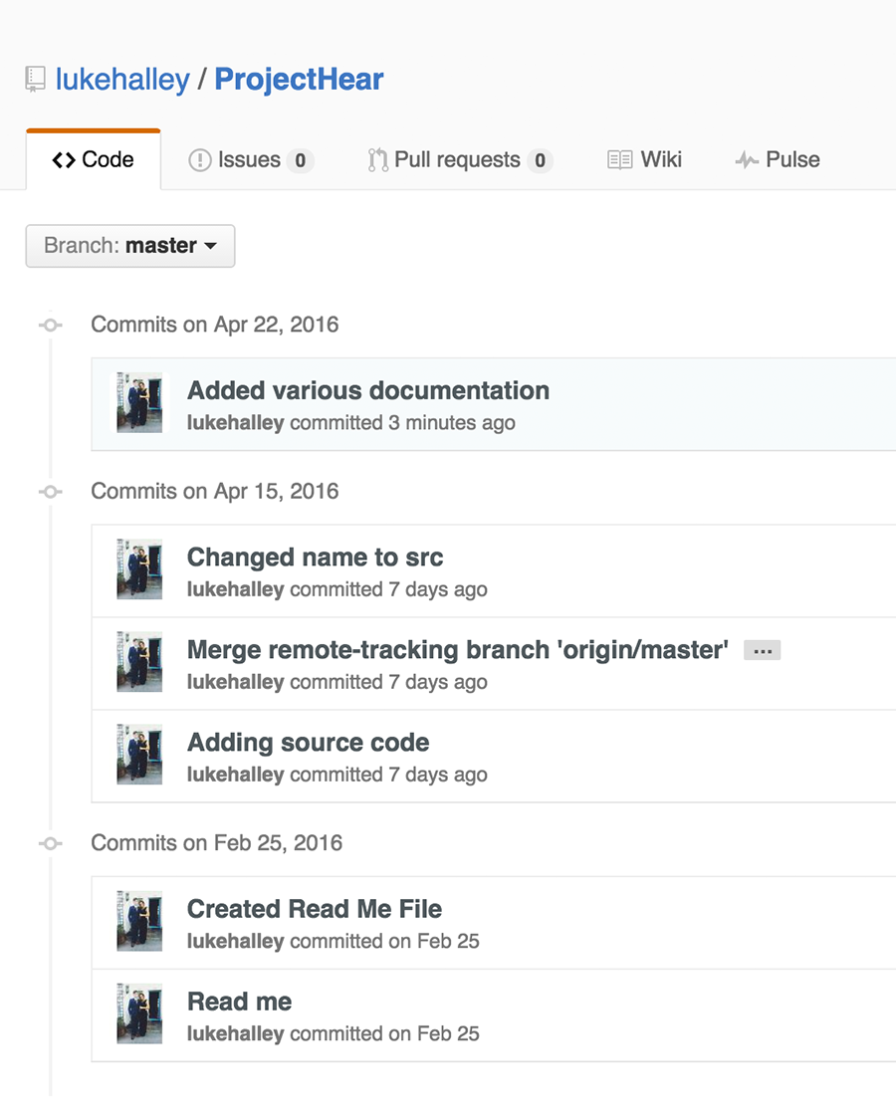
Git
Version Control
Reverting
Tutorial
Resource

Slide 7
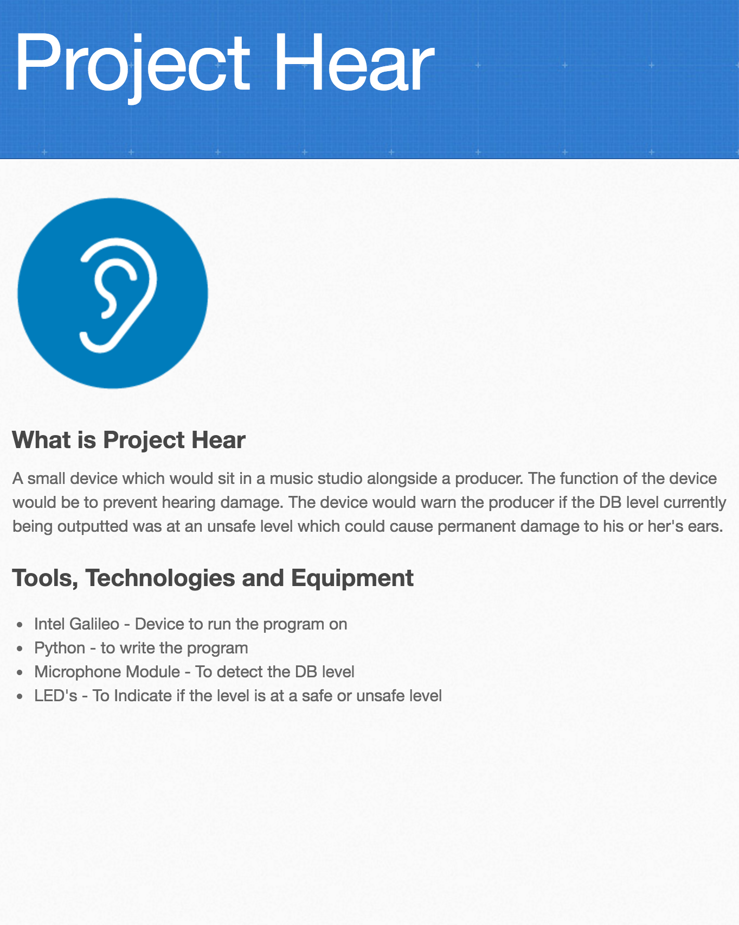
Pages
Version Control
Reverting
Tutorial
Resource

Slide 8

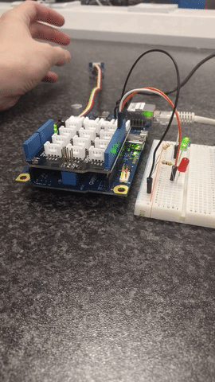
Show
Very Responsive
200Hz
Sharp Sounds
Demo

Slide 9
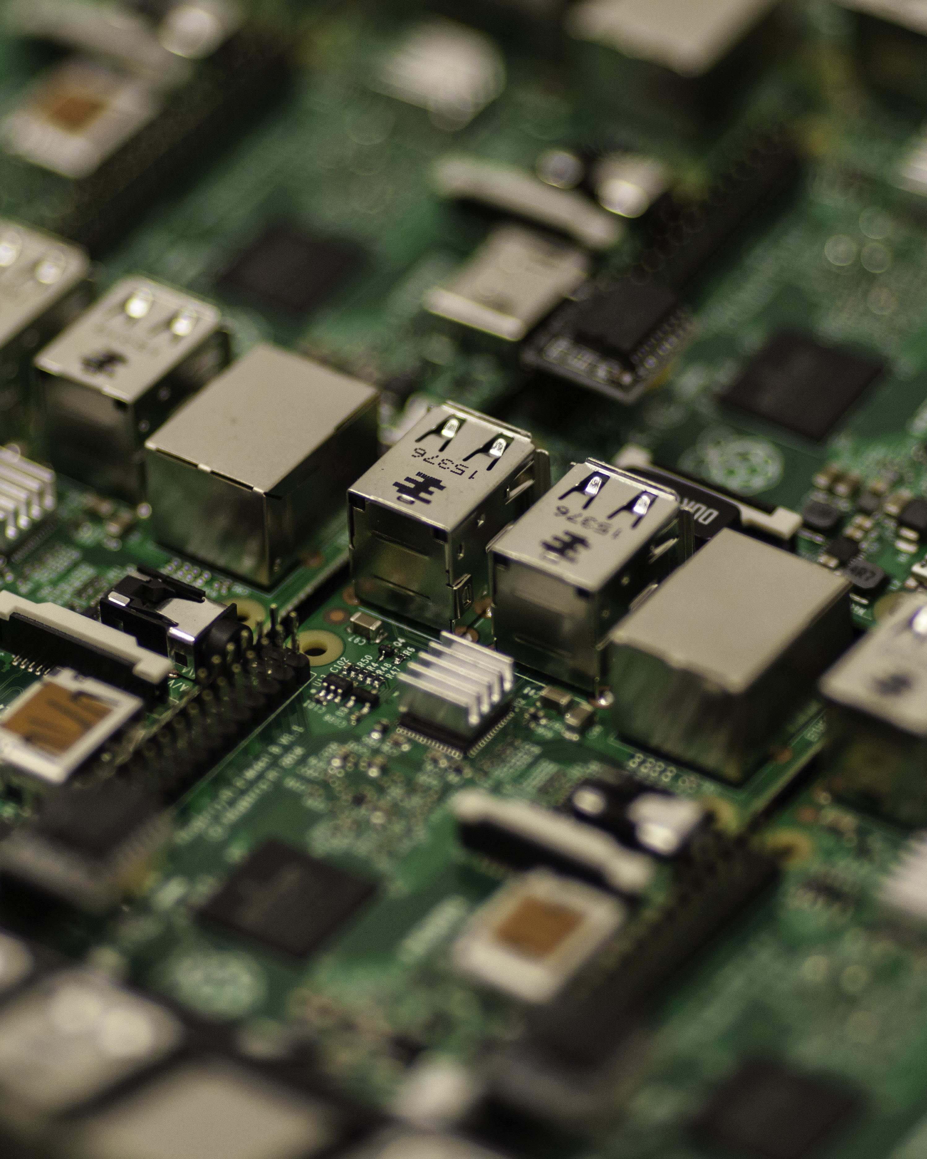

Used
Computer Systems
Web Development
Programming
Math

Slide 10
Issues
Correct Threshold
Ambience
Programming
Math

Slide 11
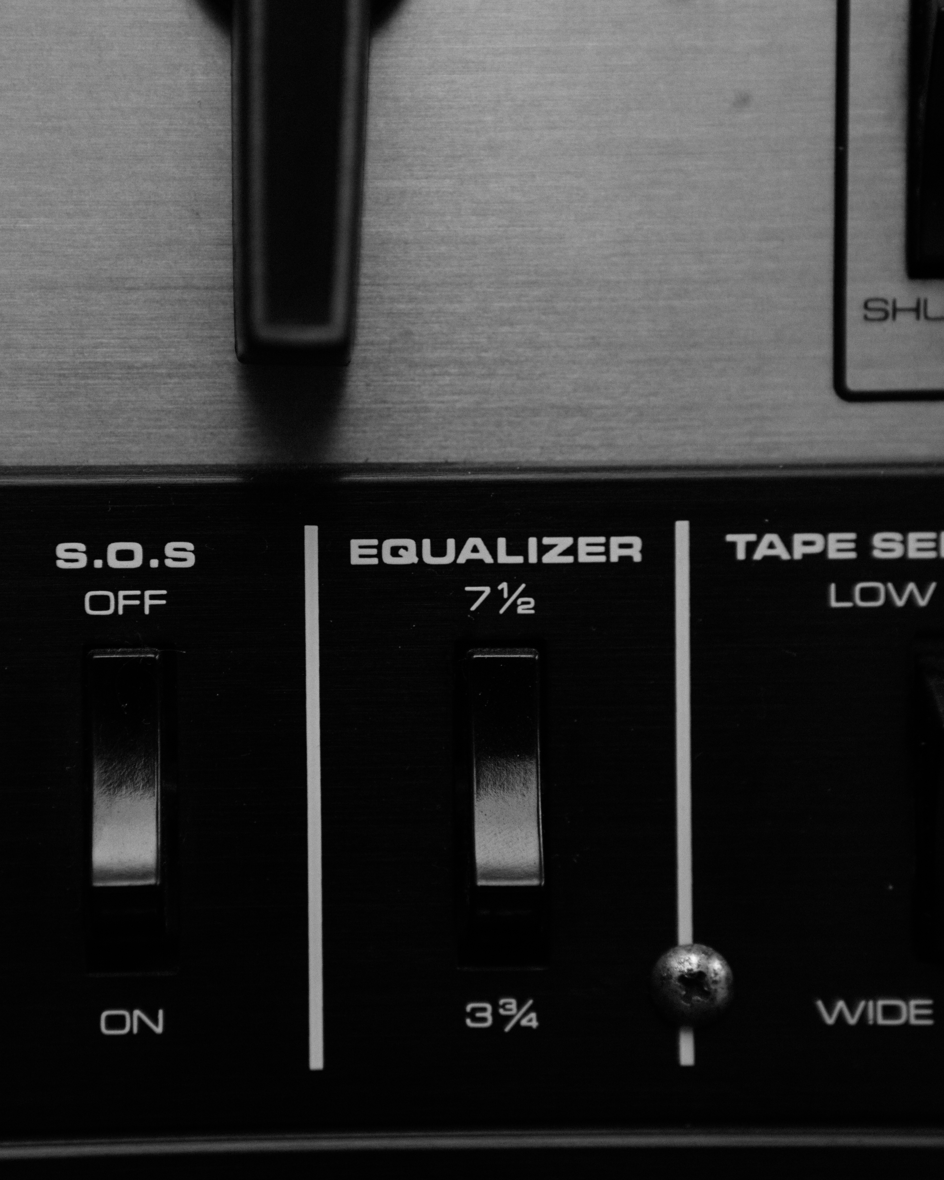
Future
Control Speaker
Tutorial
Live Use
Mobile Application

Slide 12
Thanks
Questions?

